Slide 1
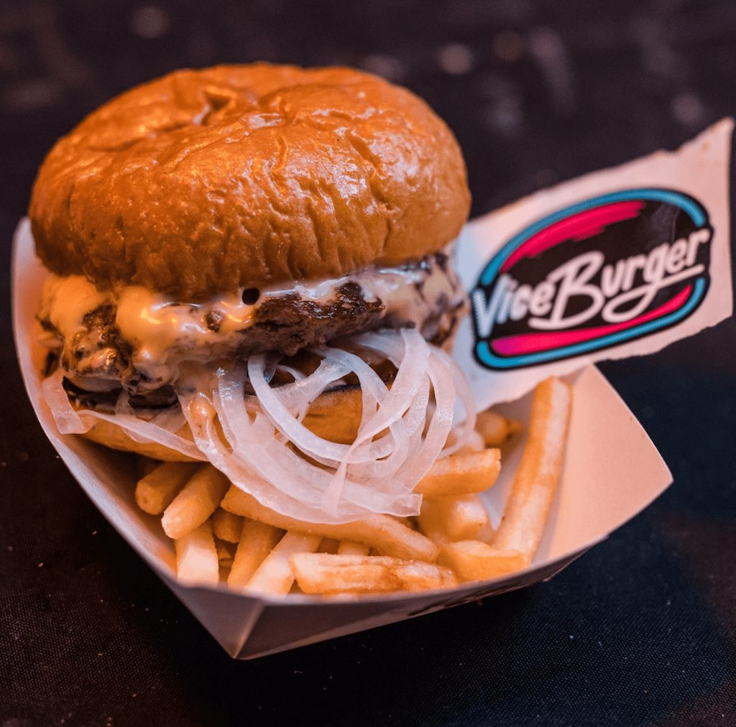
ViceBurgers
Macarena Gracia Loch

Slide 2
Brand Definition
Vice Burger is a small restaurant based on Miami Avenue that specializes in preparing a special type of burger called the Vice burger. The burger is made of fresh beef grounded daily and not frozen. The Vice burger also contains Vice sauce which is prepared daily using fresh onions, and the burger can be served using a coke or Fiji water. Ever since they established the brand, it has invested a lot of time and resources to develop a solid online brand on social media, especially on channels like Instagram, which has already gained 2,359 followers.

Slide 3
Customer/voter/client persona
Vice Burger's buyer persona is a person who is active for 3 hours a day on Instagram, follows top fast-food restaurants, and likes burger-related posts. She is financially stable and can afford to spend extravagantly, eating an average of 12 hamburgers a month. This person may or may not be married with children and lists hamburgers as her favorite food on her Facebook and Instagram accounts.

Slide 4
Customer/voter/client persona
Demographics:
Psychographics:
Narrow target:
Our online target audience is customers between 18 years to 45 years. Stay within Miami avenue, are both male and female. Their social media profiles indicate that they are single or married and may or may not have kids. These customers have blue-collar jobs that make them busy and like fast food.
Our target audience has a smartphone and spends at least 2 hours a day on social media, follows and likes burgers and other fast food accounts on social media, and likes or shares content related to burgers and fast foods. These customers also eat fast food 9 to 16 times a month and participate in social media online competitions that award customers free burgers.
Number:
The potential audience size for Vice burger, based in the Miami Avenue area, is 500,000.
Our target audience is approximately 150,000 aged between 18 to 45 years, who spend 3 hours on social media daily, are either males or females. Reside within Miami Avenue, have extra disposable income to spend, may or may not have a family, and follow pages related to a burger on social media.

Slide 5
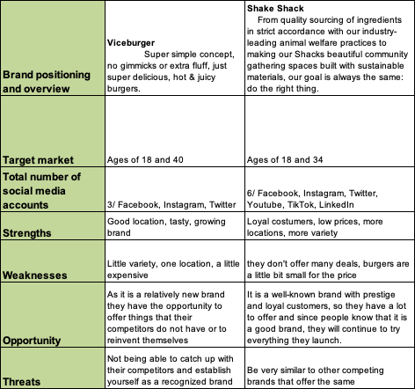
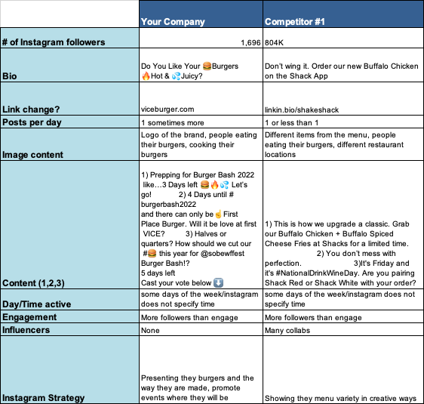
Discuss your competition:

Slide 6
Discuss the opportunities and threats
Opportunities
Threats
ViceBurger is a burger stand that is located downtown. One of its advantages is that they are usually set up near several nightclubs on weekends, which is a perfect strategy because everyone who ends the party is always looking for a place to eat. Then what better than to stop by the ViceBurger stand, which is open until late at night.
ViceBurger, being a relatively new business, has disadvantages that a consolidated company does not have as a stable place since, for example, the location may sometimes change because it is a food truck. In addition, ViceBurger works on the concept of the original burger taken to its maximum potential, so they do not have a very extensive menu of burgers like other restaurants.

Slide 7
SMART Social Media Objectives
Communication Goal:
Business Goal
Increase brand awareness among age groups between 21 and 35 year olds living in Miami starting in May 2022.
Smart Objective 1: Increase by 30% the number of Instagram users living in Miami among 21-35 who engage with us by August 2022.
Smart Objective 2: Increase the number of followers by 20% through Instagram ads by July 2022.
Increase traffic on ViceBurger's Instagram account by 40% in six months.
Smart Objective 1: Create a social media marketing strategy to increase the number of sales by 30% by July 2022.
Smart Objective 2: Increase the number of ViceBurger locations to increase the range and amount of sales by 20% by August 2022.

Slide 8
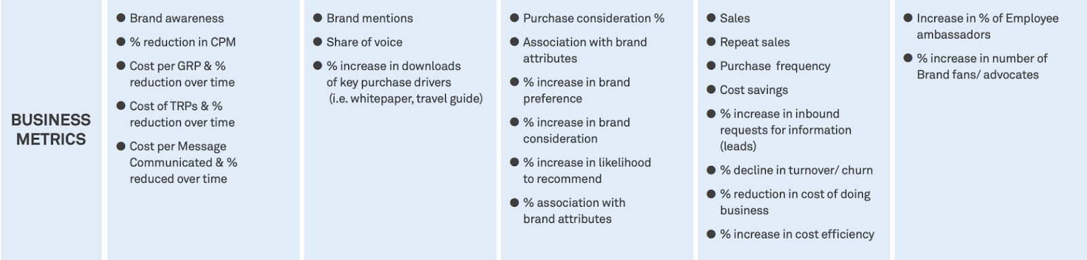
Identify the metrics you will use to measure the completion of your goals

Slide 9
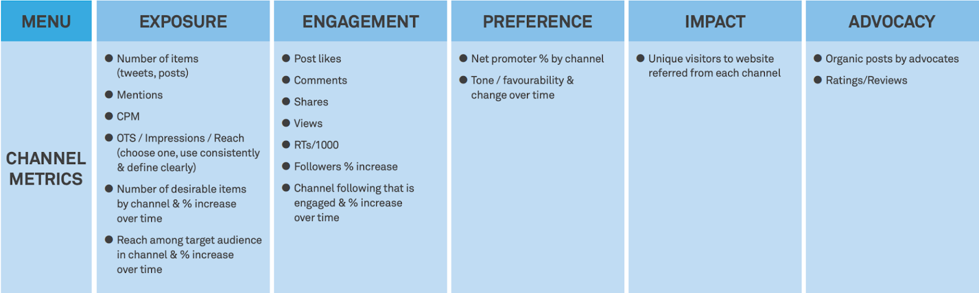
Identify the metrics you will use to measure the completion of your goals

Slide 10
Identify a social channel that will help you achieve your SMART goals
The social channel that will help achieve the SMART goals for ViceBurger is Instagram. The target audience is here since people between 21 and 35 years old spend a lot of time on Instagram discovering new content. They use Instagram to see food content, save recipes, discover new restaurants, and save those that they find interesting to try; this is when ViceBurger comes into play because, as a brand, we want to spread the message that our burgers are among the best in the zone. In order to reach our goal and thus be able to reach more people who want to try our burgers, we want to develop a relationship with influential people who promote the vision of ViceBurgers so that they can tell their followers that the burgers we have are the most delicious they can find anywhere in Miami.

Slide 11
Develop a specific message that you will highlight in this strategy
BIG IDEA
SLOGAN
Use the restaurant as a meeting point where customers can connect with people who share their passion for burgers and meet new friends feeling part of a community.
“Feeling pleasure in every bite.”

Slide 12
Develop a specific message that you will highlight in this strategy
BIG IDEA MESSAGE
BIG IDEA STRATEGY
ViceBurger is a restaurant whose primary mission is to prepare the typical American burger in the tastiest way and with fresh ingredients. As a brand, we want to invite all fans and non-fans to try the burgers we make so they can judge for themselves if we meet the desired expectations. ViceBurger is a hamburger community where people can come, meet people and share their opinions about our preparations. Our ultimate goal is to reach more and more people so that they can savor our hamburgers and realize what an original American hamburger is.
The bigi dea is to encourage people passionate about hamburgers to come and try ViceBurgers. The company represents itself as a brand that seeks to cook the typical American hamburger in the freshest and most flavorful way. ViceBurgers is characterized by its ingredients carefully prepared the same day, maintaining a fresh flavor in each bite of the burger. By bringing together many people who are passionate about trying new burgers, we will surround ourselves with people who are critical and can spread the word about our brand.

Slide 13

